Slide 1
Design Thinking Phase 2:
Analyze Insights & Create Challenge Statements
By: Vennela Gajjala, Haoyang Li, Mounika Tarigopula, Noah Placke
Team S.A.C.S (Students Against Comic Sans) (Team 8)

Slide 2
RQ: Shopping Habits in a Post-Pandemic World Among 20-24 Year Old Students Living Independently

Slide 3

College Kid Chester
Picture
Demographics:
Age: 22
Income: Middle Class
Location: Texas
Education: Some College
Relationship Status: Not Married
Employment: Full Time Student
Description: Student committed full time to studying at a University in the state of Texas who values their independence.
Personality:
Organized
Health-conscious
Spend-wise
Studious
Enjoys eating at home
Concerned about pandemic safety
Socialite
Independent
Likes Pets
Story: Chad is a college kid who has lived away from their parents for at least a year. Chad is money conscious but doesn’t mind spending a few bucks on the nicer things when needed. He continued to live away from home during the pandemic. Since the pandemic became more serious, Chad wonders what he should spend his money on as times change and the future is uncertain.
Notes:
Noah
Explore more

Slide 4

Our Participants
All participants followed the persona specified - college aged people who lived independently but most participants are male coincidentally
Some participants were in the age range but not necessarily in college but had graduated within a year
Our focus was on the independence and lack of reliance on other people, such as parents or a spouse, to control how much they spend or what they spend on - this was a success as all of our participants met this criteria so we could focus on the individual level of spending
See Appendix A for listing of participants

Slide 5
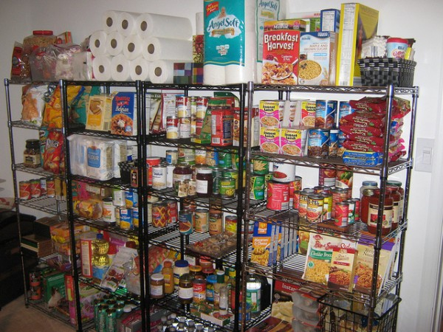
Research Methods Used
Photo Elicitation - photos of inside of fridges, freezers, and pantries
Concentric Circles - learn about the staple and luxury purchases participants made before and after pandemic
Personal Interviews - take deeper dive into habits

Slide 6
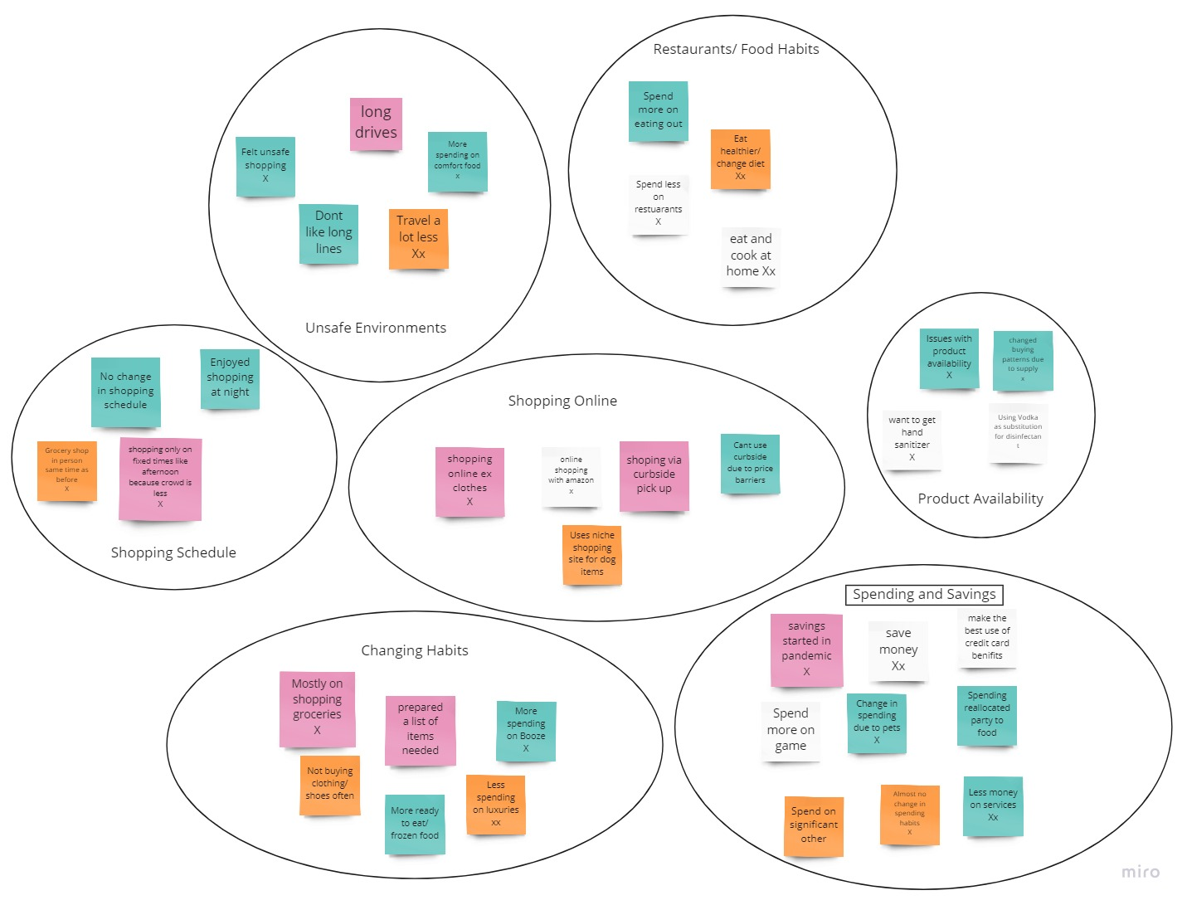
Notes:
Try to find connections between the themes and show that

Slide 7
Theme
Relationships
Shopping Habits in a Pandemic
Changes due to Uncertainty
Unsafe
Environment
Product
Availability
Fiscal Changes
Spending &
Saving
Food/
Restaurant
Habits
Changes in How people shop
Changing
Habits
Shopping
Online
Schedule
Notes:
Try to find connections between the themes and show that

Slide 8

Themes and Insights
Unsafe Environments
People are hesitant to spend time in crowded places and look for ways to avoid such situations
Restaurant/Food Habits
Peoples’ varying reactions to the pandemic has reshaped how they view food in terms of restaurants and cooking, either with them cooking more given their increased time at home or eating out more for convenience
Shopping Schedule
People kept similar shopping schedules pre and post pandemic but actively looked for ways to avoid crowded places for a more peaceful shopping experience
Product Availability
The unsteady supply chain during the pandemic has caused people stress as well as pushed them to seek alternative solutions

Slide 9
Themes and Insights
Changing Habits
The pandemic has caused people to rethink the items they buy and how the buy them. People are now trying new things such as new diets, new hobbies and getting pets during quarantine. Many of our participants have begun making a conscious effort to eat healthier foods.
Spending/Saving
Spending habits have changed according to individual lifestyles and events during the pandemic. Most people transfer saving from one area of their lives into additional spending in another ex. Money saved on entertainment goes towards eating out more
Shopping Online
People have changed how they shop for goods such as using online platforms for groceries and such due to convenience and safety but these avenues often have barriers in terms of minimum price

Slide 10
Problem and Challenge Statement
Problem: Chester has trouble finding items he needs to buy and has been traveling store to store in search of them, and wants an easy way to see what’s in stock, where, and at what price before he spends time traveling everywhere.
Challenge: How might we minimize the time and effort needed by shoppers to find the groceries they need during the pandemic in order to save time and reduce expenditures?

Slide 11



Laddering Challenge Statement
Ladder up: How might we minimize the stress of shoppers during the pandemic?
How might we minimize the time and effort needed by shoppers to find the groceries they need during the pandemic in order to save time and reduce expenditures?
Ladder down: How might we minimize the time needed by shoppers to compare the availability of products between different stores?

Slide 12

Opportunities in Research
Somewhat awkward doing research virtually and not in person
Difficult to get participants to remember/focus on what their spending is like
Can only rely on what they say since photos of fridge and pantry only focus on the grocery spending and not other spending
Real time data would be useful such as shopping with the person
Researcher bias due to the fact that we know the people that are participating
Couldn’t record sessions for future playback to review points
Participant gender leaned heavily towards males which could skew results

Slide 13

Reflection
Hard to find willing participants that will give useful insight and elaborate on their answers
Information we may have gotten from participants could be inaccurate or they may have just been telling us things they think we want to hear
In order to get the best feedback possible for research, it’s ideal to talk to a ton of people that you don’t know so that there are no biases
Even if you feel like you’re annoying, you need to dig deeper to get the information you want

Slide 14
Appendix A: Participants
21 Year old Female Undergrad College Student
22 Year old Male Undergrad College Student
24 Year old Male Recent Graduate College Graduate, working professional
22 Year old Male Graduate College Student
22 Year old Male Graduate College Student
19 Year old Male Undergrad College Student
21 Year old Female Graduate College Student
22 Year old Male Graduate College Student
24 Year old Male Recent Graduate,working professional
23 Year old Female College Graduate, working professional
22 Year old Male Undergrad College Student, just left Army
22 Year old Male Undergrad College Student

